Slide 1


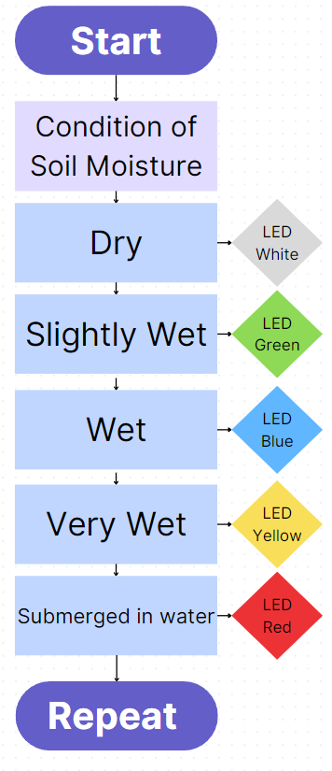
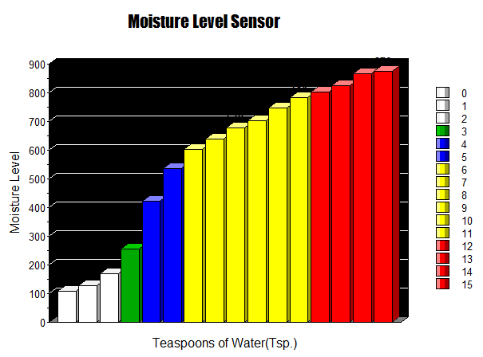
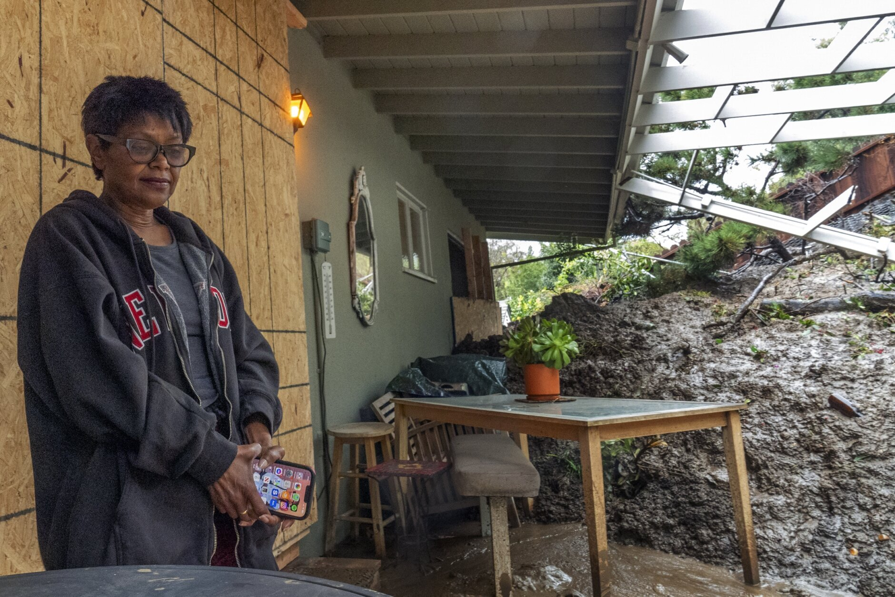
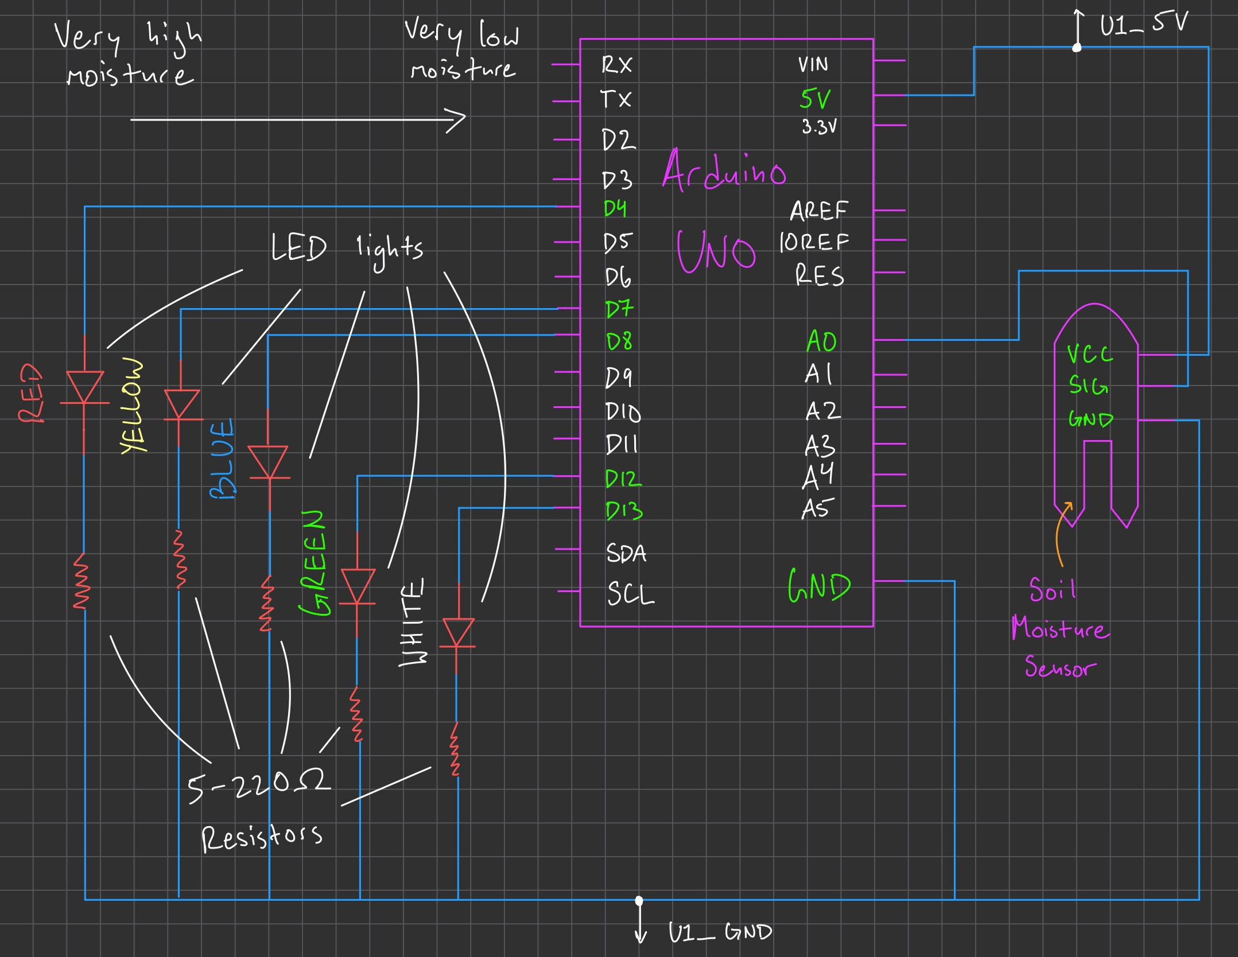

Soil Moisture Sensor for Beverly Hills Mudslides
Jose Perez Cruz, Michael Wong, Aurian Malhotra
ENG 003
Introduction
The persistent threat of mudslides, particularly during heavy rainfall in Southern California, poses a risk to infrastructure, communities, and the environment. Beverly Hills, located in hilly terrain, is greatly susceptible to mudslide occurrence.
We have created a prototype soil moisture sensor which will indicate, during a rainy day, whether a hill is susceptible to a mudslide.
Results
Results
Discussion of Results
Through a graph comparing teaspoons of water added to soil vs moisture levels detected, patterns were identified to indicate when the LEDs would light up for certain moisture level values as more water was added.
The sensor allows clients to detect possible mudslides through visual and audio cues as the device detects high moisture levels. LED lights correspond to assigned moisture level values, with an alarm sound produced at the highest level to serve as a warning system.
The graph is showing the change in moisture level which is dependent on the amount of teaspoons of water added
Methods
Needs
Residents need to be alerted of incoming mudslides
This would help citizens evacuate and minimize property damage
Approach
Create a system using LED lights to create a visual warning system
Create a system using a buzzer to create an auditory warning system
Constraint: Battery Life
Future Improvements
Louder signal indicating an incoming mudslide
Bigger and brighter LED lights
Our customers will be using this from their homes so we want to ensure they are very easily able to hear/see the sensor go off indicating a potential mudslide
Circuit Diagram
References
Brocca, L., Ciabatta, L., Massari, C., Camici, S., & Tarpanelli, A. (2017). Soil Moisture for Hydrological Applications: Open Questions and New Opportunities. *Water (Basel)*, 9(2), 140-140.
A. Wicki, P.-E. Jansson, P. Lehmann, C. Hauck, and M. Stähli, "Simulated or measured soil moisture: which one is adding more value to regional landslide early warning?" *IEEE*, pp. 1-5, 2024.
This woman is sad
Acknowledgements
The authors would like to acknowledge the guidance of Professor Vivian Vuong and teaching assistants Peter Russell and Ceilidh Douglas in ENG 003.

